Slide 1



Introduction
Task 1
Task 2
Task 3
Task 4
Task 5
Task 6
Task 7
Conclusion
Web Presence Project
CRAFTING & COMPELLING WEBSITE ANALYSIS, AUDIT AND RECOMMENDATIONS
KAAVYASHREE MBT-12

Slide 2



Introduction
Task 1
Task 2
Task 3
Task 4
Task 5
Task 6
Task 7
Conclusion
Company Selection
I have Selected the Company TCS for this web presence project
ABOUT TCS
Tech is a forward-thinking digital solutions provider offering cutting-edge services in enterprise IT modernization, AI & automation, cybersecurity, and cloud transformation. With a mission to digitally empower businesses, they blend strategy, technology, and innovation to deliver exceptional customer value.

Slide 3

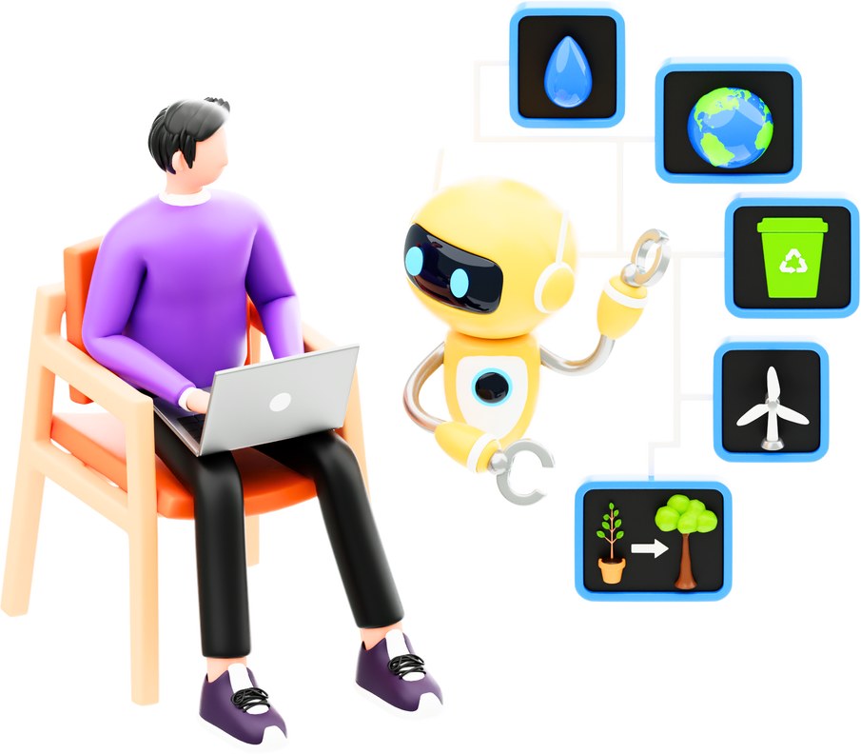

Introduction
Task 1
Task 2
Task 3
Task 4
Task 5
Task 6
Task 7
Conclusion
ENTERPRISE IT MODERNIZATION
Product and Service Descriptions
We're diving into a team design project, still in the brainstorming phase, where we're refining the initial concept.
AI & AUTOMATION
Harnessing intelligent automation and machine learning to streamline decision-making and optimize workflows.
CYBERSECURITY & RISK MANAGEMENT
Providing end-to-end solutions to secure digital assets and mitigate evolving cyber threats.

Slide 4



Introduction
Task 1
Task 2
Task 3
Task 4
Task 5
Task 6
Task 7
Conclusion
Overview
Next Phase
Discussion
WEBSITE PLATFORM IDENTIFICATION
The website is built using WordPress, elementor and other plugins.

Slide 5

Introduction
Task 1
Task 2
Task 3
Task 4
Task 5
Task 6
Task 7
Conclusion
Responsive Design Testing
TOOLS USED
HOMEPAGE
ABOUT US SECTION
SERVICES SECTION
Google Mobile-Friendly Test.
Mobile-friendly design with clear layout.
Well-structured content adapts nicely to mobile view.
Responsive grid layout.
SOCIAL SECTION
Clean and user-friendly on mobile devices.
Interactive form works well on all screen sizes.

Slide 6

Introduction
Task 1
Task 2
Task 3
Task 4
Task 5
Task 6
Task 7
Conclusion
Brainstorm
Next Phase
Recap
Website Mistakes Identification
Suggestions for Improving the TCS Website
Optimize image sizes to reduce load times.
Simplify navigation for a smoother user journey.
Maintain consistent font styles and color themes.
Use Content delivery network for larger images or files.
Improve visibility of call-to-action (CTA) buttons.

Slide 7


Introduction
Task 1
Task 2
Task 3
Task 4
Task 5
Task 6
Task 7
Conclusion
Website Best Practices
Focus on intuitive navigation and minimal design clutter.
Mobile-first approach ensures cross-device compatibility.
Fast-loading content through multimedia optimization.
Consistent brand elements across all pages.
Clear and bold CTAs for better conversions.

Slide 8


Introduction
Task 1
Task 2
Task 3
Task 4
Task 5
Task 6
Task 7
Conclusion
OBJECTIVE
Generate leads for AI & Automation Solutions.
KEY FEATURES
Eye-catching hero banner with a clear value statement.
Quick overview of AI benefits in business growth.
Landing Page Design
LANDING PAGE DESIGN
click here to view
kaviya.theprolayers.com

Slide 9

Introduction
Task 1
Task 2
Task 3
Task 4
Task 5
Task 6
Task 7
Conclusion
Introduction
Agenda
Motto
Overview
Brainstorm
Next Phase
Recap
Discussion
CONCLUSION
This project showcases the strategic development of a digital presence for TCS, emphasizing design, functionality, and lead generation. Through research, analysis, and best practices, I have developed a compelling landing page to promote their AI & Automation services. The improvements and suggestions provided are tailored to enhance user engagement, brand visibility, and conversion rates.

Slide 10
Borcelle Studio
Introduction
Agenda
Motto
Overview
Brainstorm
Next Phase
Recap
Discussion
Thank you

